Slide 1
The Power of Shell
Puterea Liniei de Comanda
prezentare de Stefan E.

Slide 2

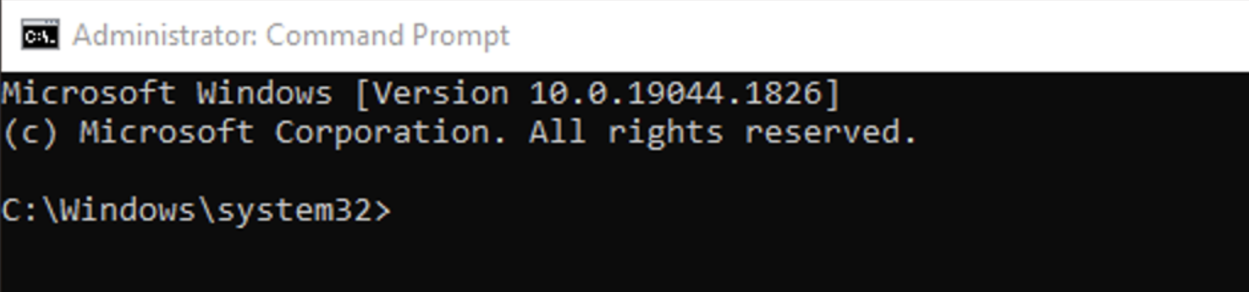
Getting Started with Shell
Linux (Mac Terminal)
Try the Following Commands:
$ date
$ echo Hello Shell!
$ pwd or $ echo %cd%
$ echo $PATH
Use cd and cd .. to navigate through directories. Then ls or dir to see the files inside a directory.
Windows (CMD)

Slide 3
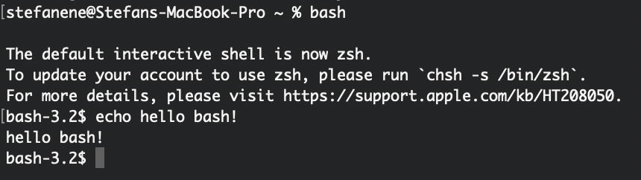
Bash vs. Shell
The shell is the software that interprets and executes the various commands that we type in the terminal.
Bash = Bourne Again Shell; it’s a Unix shell and command language
Change your shell Terminal into a Bash one: type the $ bash command in your terminal and it should prompt your next command line in Bash!
Notes:
"shell" is a broad term that refers to any program that provides a command-line interface, "Bash" is a specific type of shell that is widely used in Unix/Linux systems.

Slide 4
Back to Shell!
Exit out of your bash terminal using the $ exit command.

Slide 5
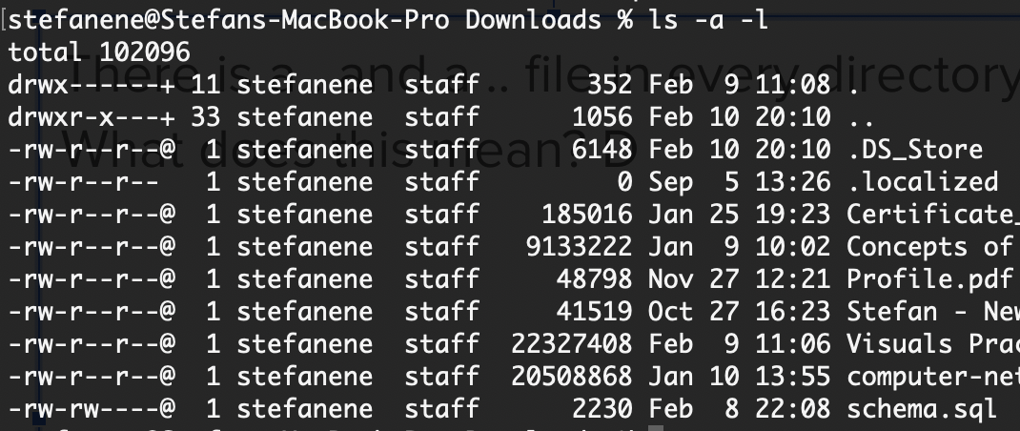
EVERYTHING is a File
Try these commands:
$ mkdir <foldername>
$ cat <filename> or $ type <filename>
$ touch or $ ni or $ echo.> <newfilename>
Make sure you ls or dir every now and then to check the status of your directory and respective files in it.
There is a . and a .. file in every directory. What does this mean?
To show all files, including hidden and system files
$ ls -a or dir
To show file permissions (read, write, execute) and size in bytes
$ ls -l or $ icacls <filename>
Put them all together: show hidden files and permissions & sizes
$ ls -a -l
Notes:
fişier

Slide 6
Redirecting Output to File
Things we can do with the > operator in our shell command line:
Redirect standard output
Redirect standard error
Copy/rename files
Try copying your test.txt file’s content from the previous exercise into a new file named testcpy.txt using the > operator.
Try the following exercise:
Navigate to a know directory
$ touch or $ echo.> test.txt
$ echo Hello > test.txt
$ cat or $ type test.txt
(optional) $ rm or $ del test.txt
What do you notice happened inside the newly created text file?

Slide 7
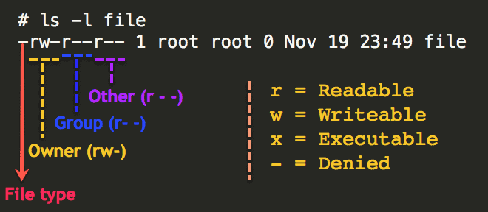
File Permissions (LINUX)
Try the following exercise:
Make a new file for a bash script
Hint: needs to be a .sh file
Check the current file permissions
Make it a eXecutable :)
Hint: + adds, - subtracts
We will write later into the file to make it an executable script, that we can run using the $ ./[filename] syntax.
All files can be read, written, executed, or combination of these. The $ chmod command (abbrev. of change mode) can be used to change the access mode of a file.
First, view all the file permissions using $ ls -l:

Slide 8
Searching Commands
To search in a file, you can use the command grep, which looks like:
$ grep <flags> '<regular expression>' <filename> or
$ findstr <search-string> <filename>
To search for a process of which you know the name of, you can use pgrep:
$ pgrep <process_name>
Try the following exercise:
Search for all “e”s in your .txt file
Use the $ ps command (more on it soon) and search for a process’s ID once you have the name
Notes:
grep "e" myfile.txt

Slide 9
Pseudonyms - Creating Bash Aliases
An alias replaces a string that invokes a command in the Linux shell with another user-defined string. The $ alias and $ doskey commands are mostly used to replace long commands, improving efficiency and avoiding potential spelling errors. Aliases can also replace commands with additional options, making them easier to use.
To create an alias, you can use the following command format:
$ alias SHORTCUT_NAME= ”[command]” or
$ doskey SHORTCUT_NAME= [command]
Exercise: Create a shortcut command named np that you can use to open a file of your choice in notepad++.
Notes:
.cue -> mapping a command/shortcut
Exercise: make chmod to x a shortcut

Slide 10
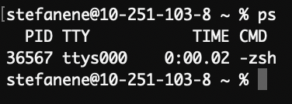
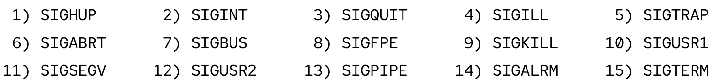
Monitoring Processes & Signals (SIG)
Use the command $ ps or $ tasklist
in order to view all the running processes and their respective IDs (pid) inside the terminal.
Use the command $ kill -l in order to view the signal list.
This command is used to send a signal, killing a process (SIGKILL or SIGSTOP)
Windows: Use the command $ tasklist then
$ taskkill /F /PID <PID> to kill a process.
Try using the two commands you learned above to kill the terminal process! View all your processes, get the correct pid, then put that value into the kill command (Hint: you might need a flag #)

Slide 11
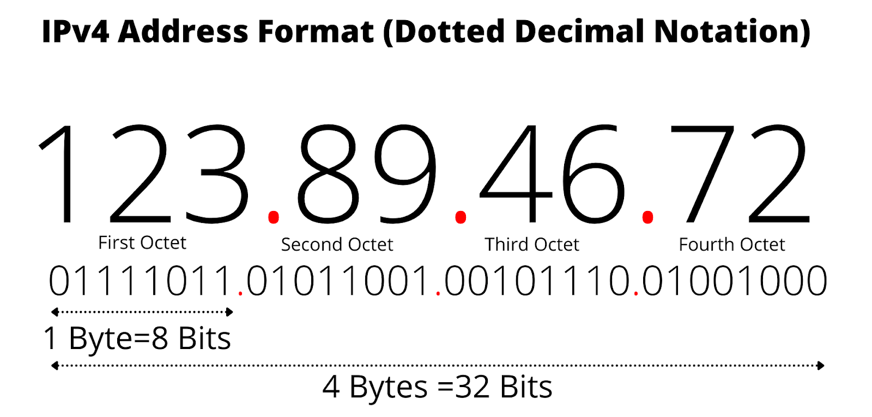
Networking in your Command Line
Let’s get your IP address!
In the Windows CMD, use $ ipconfig to see all the information regarding your machine’s networking connections.
On Mac, use $ ipconfig getifaddr en0 to get the IP address specifically, as the ipconfig command needs parameters here.
← Continued: tracing packets - Why the Internet Works?

Slide 12
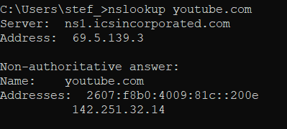
Networking in your Command Line - Part 2
Let’s go further into the networking commands available in the command line
To see the network record of a domain (IP address and name), use:
$ nslookup <domain>
Try looking the IP address of a
website of your preference! ----->

Slide 13
Networking in your Command Line - Part 3
To see how long it takes to sent packet of n bytes (64 or 4 by default), you can use:
$ ping [options] <domain>
To see the route your machine takes to get to a certain destination, use:
$ traceroute or $ tracert <domain>
Try this exercise:
Run the $ ping command with the -c 1 or -n 1 option. What differences do you notice?
See how many jumps it takes you to get to youtube.com. In other words, trace the network route your packets take to get there.

Slide 14
Extra Step for Windows Users (without Unix)
https://git-scm.com/download/win
Git Bash !

Slide 15

Scripting Exercise
We will write a bash script that gets all the IP addresses on the LAN.
# Get the local IP address and subnet |
local_ip=$(ifconfig | grep 'inet ' | grep -v '127.0.0.1' | |
awk '{print $2}') |
Windows:
# Get the local IP address and subnet |
local_ip=$(ipconfig | grep -E 'IPv4 Address.*: [0-9.]+' | | awk '{print $NF}') |
subnet=$(ifconfig | grep 'inet ' | grep -v '127.0.0.1' | awk '{print $4}') |
subnet=$(ipconfig | grep -E 'Subnet Mask.*: [0-9.]+' | awk | '{print $NF}') |
Notes:
local_ip=$(ifconfig | grep 'inet ' | grep -v '127.0.0.1' | awk '{print $2}'): This line retrieves the local IP address by executing the ifconfig command. It filters the output using grep to find lines containing 'inet ' (which indicates an IP address) and excludes lines with '127.0.0.1' (localhost). Finally, awk is used to extract the second field, which is the IP address, and assign it to the variable local_ip
subnet=$(ifconfig | grep 'inet ' | grep -v '127.0.0.1' | awk '{print $4}'): Similar to the previous line, this retrieves the subnet by extracting the fourth field from the output of the ifconfig command. The subnet is usually in the format "255.255.255.0" or similar.

Slide 16
Scripting Exercise - Pt 2
Now we can write the part that actually displays the existent addresses:
# Generate the network range |
IFS='.' read -r -a octets <<< "$local_ip" |
network="${octets[0]}.${octets[1]}.${octets[2]}" |
# Iterate over the network range and check each IP |
for ((i=1; i<=254; i++)) |
do |
#code |
done |
Notes:
IFS='.' read -r -a octets <<< "$local_ip": This line splits the local_ip variable into an array called octets using the dot character as the delimiter. Each element of the array represents an octet of the IP address.
network="${octets[0]}.${octets[1]}.${octets[2]}": This line reconstructs the network portion of the IP address by joining the first three octets together with dots. The resulting network address is stored in the network variable.

Slide 17
Scripting Exercise - Pt 3
The inside code:
ip_address="${network}.${i}" |
|
# Skip the local IP address |
if [ "$ip_address" == "$local_ip" ]; then |
continue |
fi |
|
# Check if the IP address is reachable |
if ping -c 1 -W 1 "$ip_address" > /dev/null 2>&1; then|
echo "IP address found: $ip_address" |
fi |
Notes:
ip_address="${network}.${i}": Inside the loop, this line generates the IP address by appending the current value of i to the network variable. It forms each IP address in the network range.
if [ "$ip_address" == "$local_ip" ]; then continue fi: This condition checks if the generated ip_address is equal to the local_ip. If they are the same, it means the current IP address is the local IP, so the continue statement is used to skip the rest of the loop and move to the next iteration.
ping -c 1 -W 1 "$ip_address" > /dev/null 2>&1: This line sends a single ping packet (-c 1) to the ip_address with a timeout of 1 second (-W 1). The output of the command is redirected to /dev/null to discard any display on the terminal. The 2>&1 redirects the error output (stderr) to the same place as the standard output (stdout).
if [ $? -eq 0 ]; then echo "IP address found: $ip_address" fi: After executing the ping command, the script checks the exit status of the previous command using $?. If the exit status is 0, it means the IP address is reachable, and the script displays a message indicating that the IP address has been found.
The loop continues with the next IP address until it reaches the end of the range (254).

Slide 18
Extra Step for Windows Users (without Unix)
https://git-scm.com/download/win
Git Bash !

Slide 19
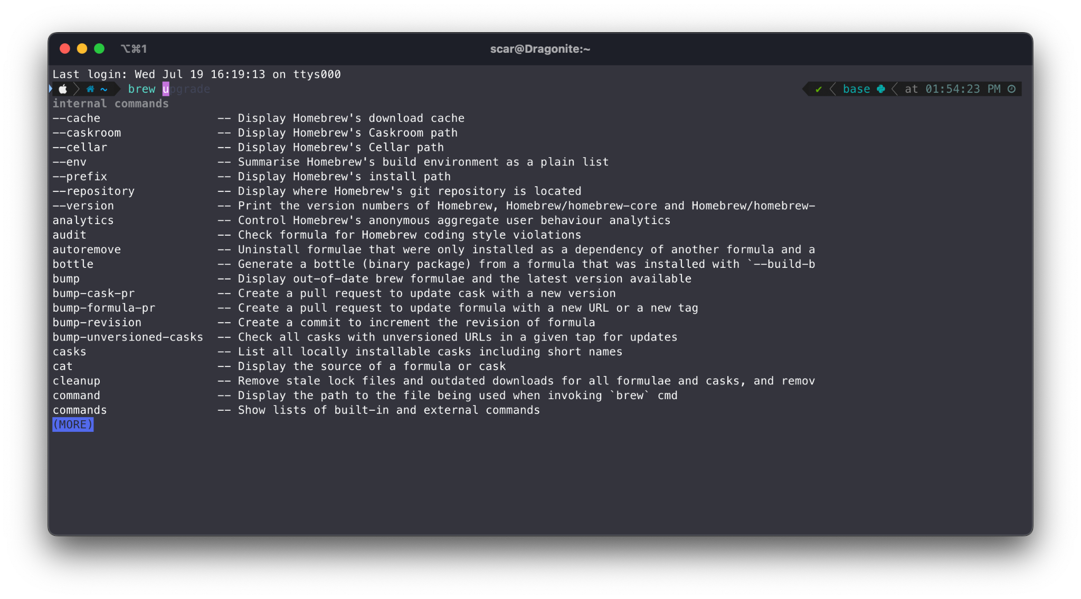
The Power Of Package Managers
Package managers serve as an easy to use layer for managing, installing and upgrading command line programs (and even desktop programs too!)

Slide 20
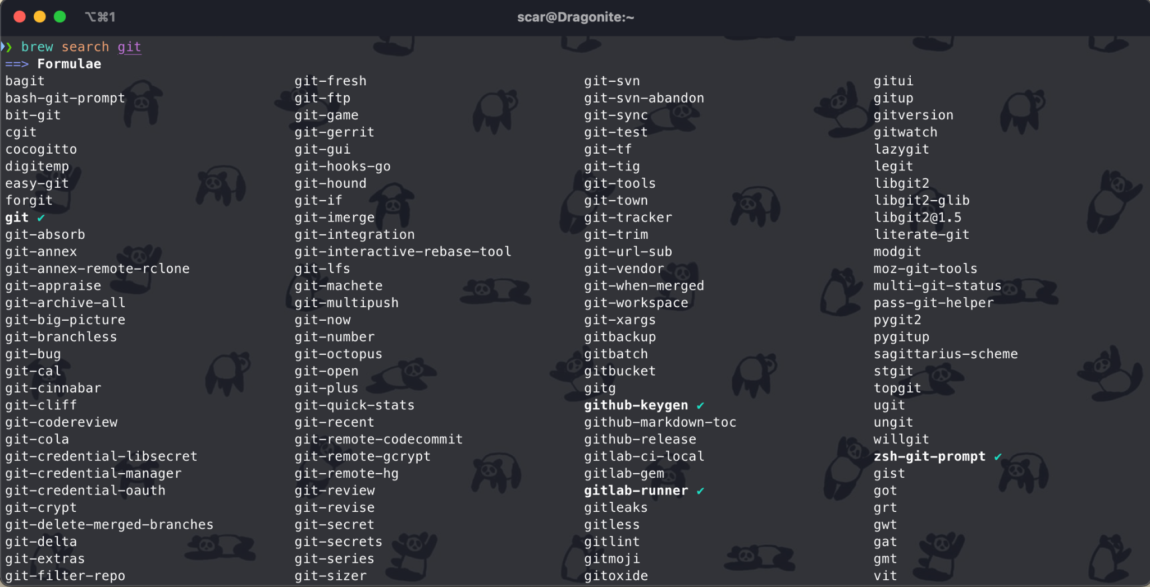
How can we use it?
It’s simple! Let’s take git for example. All we have to do is check if the package manager carries the formulae in it’s repository, and install it!
Installing formulae is as easy using:
For CLI terminology:
> brew is used as the main caller for the package manager, in my case this being Homebrew
> install is the command we pass to the package manager
> git is the formulae!
> brew install git

Slide 21
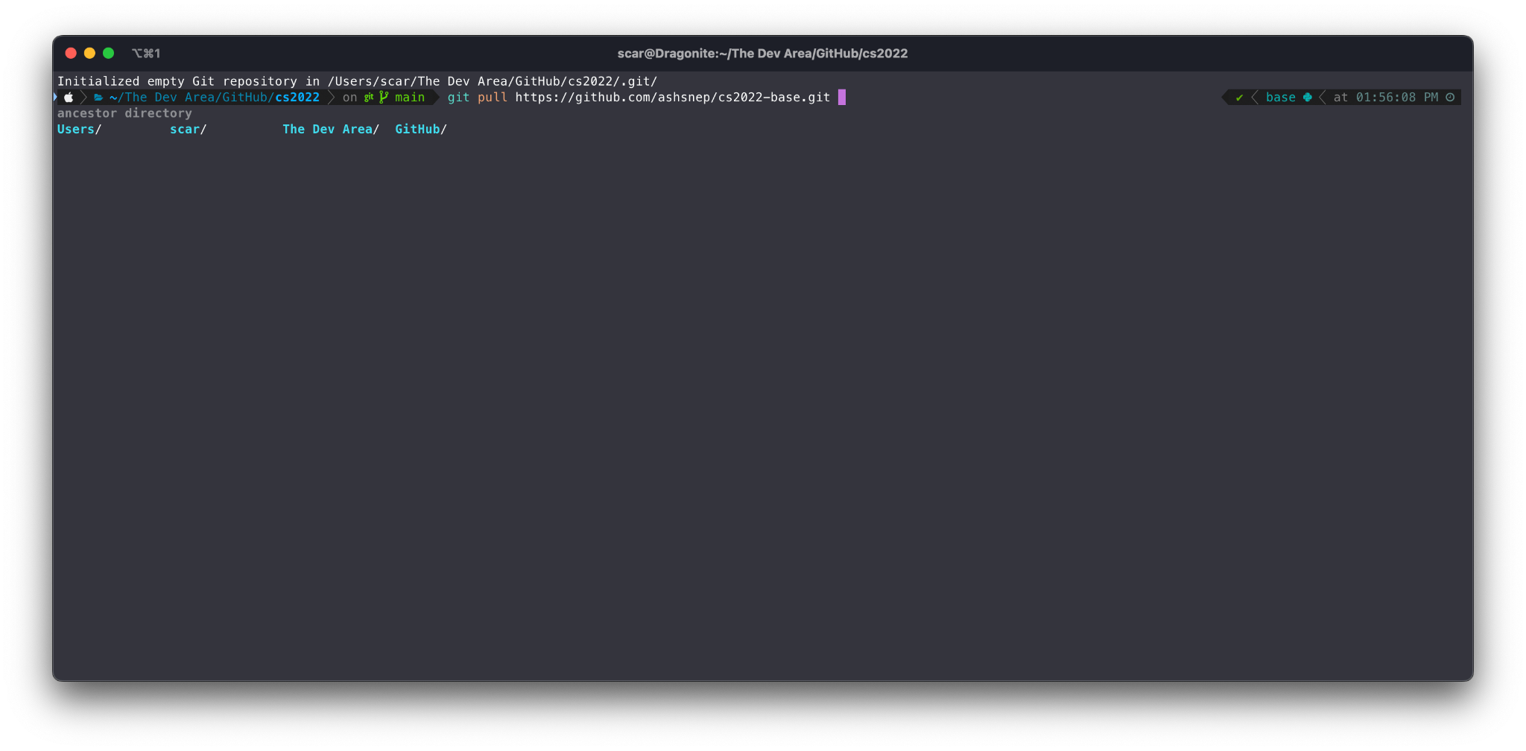
What are the advantages?
After installing a formulae, this can be used in the system terminal as a direct command, without the need of external tools or other applications!
In the case of git, this will work exactly like Git Bash on Windows systems!

Slide 22
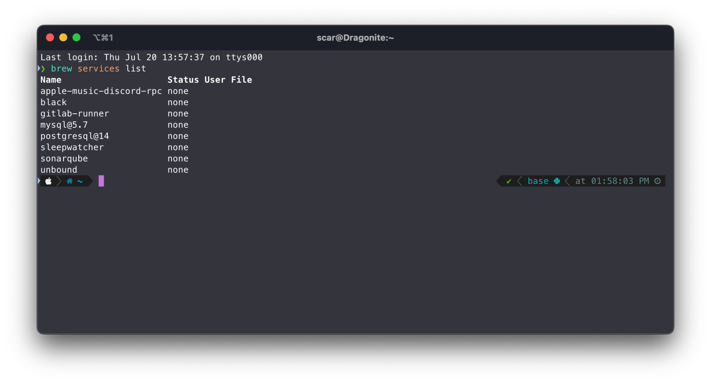
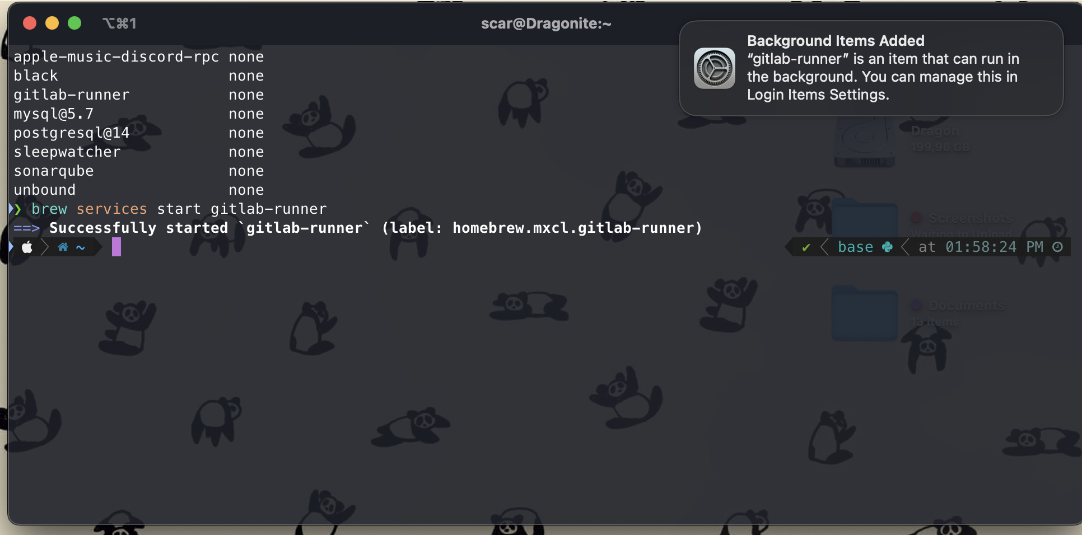
Another cool advantage is the ability to run services as background processes straight from the command line! This is similar to a startup process in Windows!

Slide 23
The final advantage in brew’s case, would be the usage of casks. These are a variation of formulae, that allow direct installation of desktop applications, by passing the --cask flag when installing something. This in turn allows to keep both CLI formulae and desktop applications up to date using one or two commands!
For example:
By using this command, brew will install Firefox’s desktop build as a standalone application. Afterwards, all that would need to be done is to use a couple simple commands to keep everything up to date!
> brew install --cask firefox
> brew update // updates repository sources
> brew upgrade //upgrades installed packages

Slide 24
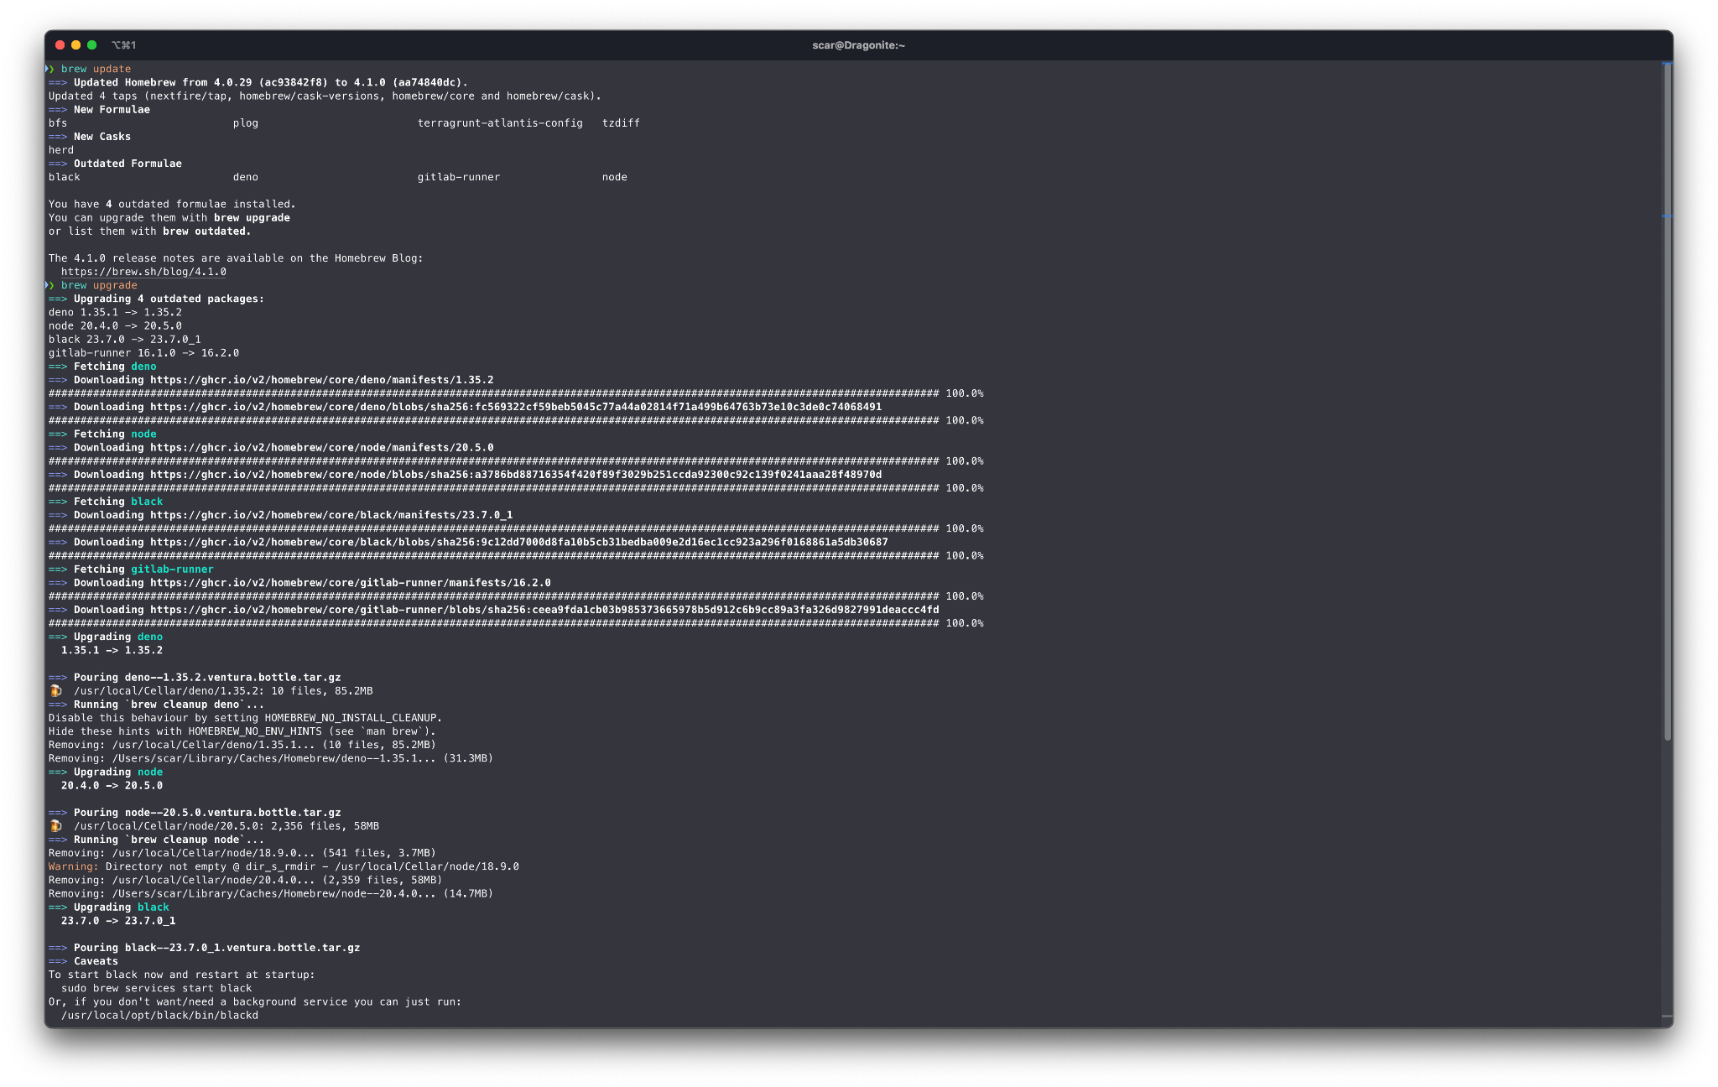

Slide 25
Alternatives!
As with everything open source, there are a lot of alternatives on the market, some of which you will encounter in the development world! Python carries its own package manager called pip, or in some distributions, pip3. This package manager allows installing packages that Python can use these installed packages in its interpreter.
This in turn can be combined with Anaconda, or conda for short, for splitting different Python installs with different packages for different purposes!

Slide 26
More Alternatives!
On the Windows side of things, you have package managers such as winget and Chocolatey, or choco for short. These will more or less serve the same purpose as brew does on macOS (and Linux!).

Slide 27
Since it’s all Open Source…
Since most package managers across all operating systems are open source, there’s nothing stopping you from even building your own, either by forking an existing manager and adding features, or by building your own from scratch!
Tinker along!

Slide 28
The End, Happy Scripting!

